Slide 1

Introduction to Lean

Slide 2
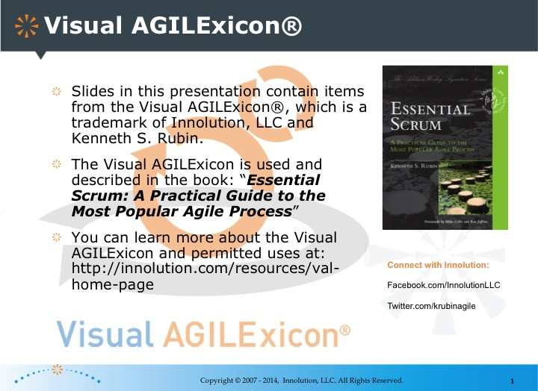
backup

Slide 3
Caveat: Lean and a Agile
Lean/agile often used interchangeably
Evolved separately but overlap
Popularised by (AMONG OTHERS)
Mary Popendyke – lean software development
David Anderson – Kanban method
Eric Ries - lean start-up

Slide 4
Lean by defination
Lean is the act of reducing waste and adding customer defined value to products and services.
The fundamental principles of Lean methodology are based on eliminating all forms of waste and increasing customer perceived value with everything we do

Slide 5
Where is Lean Used?
Lean originated in manufacturing in late 1940s
Toyota Production System (JIT - Just in Time)
Lean Medical
http://www.leanhealthcareexchange.com
Lean Software Development
Tom and Mary Poppendieck
Lean Start-ups
Eric Ries

Slide 6
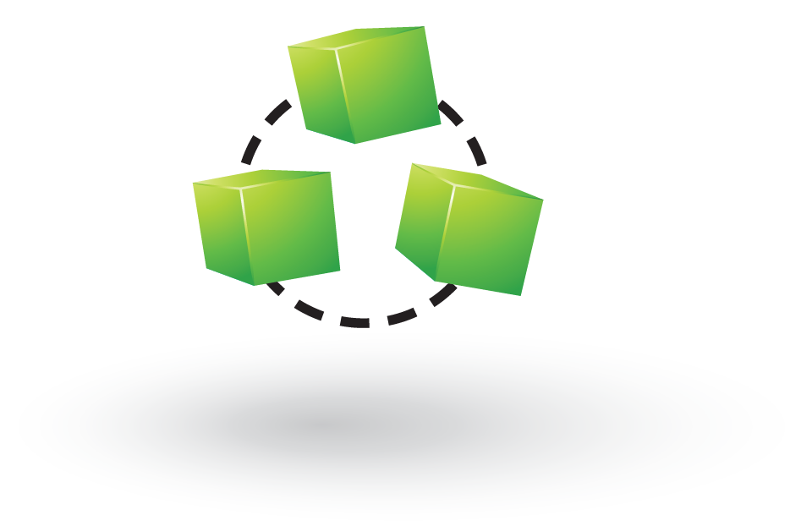
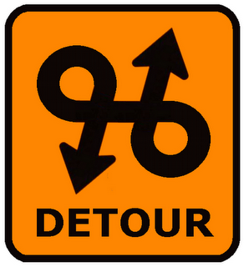
TASKS
Ball Point Game – Round 1

Slide 7

5 Lean Principles
Value in the eye of the customer
Working in value streams
Maximize flow and create pull
Empower the team
Continuous improvement

Slide 8

Value In The Eye Of The Customer
What is value in the eye of the customer for you?

Slide 9

Working in value streams
Value stream mapping

Slide 10

Maximize Flow And Create Pull
Pull systems
Maximize Flow

Slide 11

Empower the team
Respect people
Everyone plays
Gemba

Slide 12

Continuous Improvement
5. Continuous improvement

Slide 13
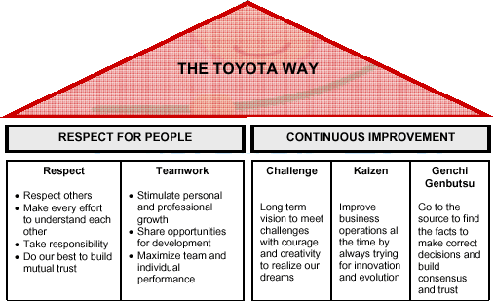
Origins
The Toyota production system
In 2001, Toyota overtook General Motors in terms of sales
With 1/10th of inventory
This Photo by Unknown Author is licensed under CC BY-SA-NC

Slide 14
Genchi Genbutsu (現地現物 ?)
Means "go and see" and it is a key principle of the Toyota production system. It suggests that in order to truly understand a situation one needs to go to Gemba (現場) or, the 'real place' - where work is done

Slide 15
The Toyota Production System: Lean Manufacturing
Production “pulled by customer”
Value production in a stable and continuous flow, without stops, batches, queues or departments
(No SILOS)
Build quality in: Jidoka
Continuous improvement: Kaizen
Production “pulled by customer”
Value production in a stable and continuous flow, without stops, batches, queues or departments
(No SILOS)
Build quality in: Jidoka
Continuous improvement: Kaizen

Slide 16
The Toyota production system lean manufacturing…
Avoid waste
Muda: valueless stages
Muri: overload on people and equipment
Mura: uneven production pace

Slide 17
Flow
Building on Flow

Slide 18

TIMWOOD
Transport – Unnecessary movement of things
Inventory – Documents, designs
Motion – Unnecessary movement of people
Waiting – People or product waiting
Over production – Sooner, faster or greater than required
Over processing – beyond the standard required
Defects

Slide 19
Bottlenecks
What bottlenecks have you experienced during creative processes, and problem solving?

Slide 20
Learning is a Major Bottleneck in Creative Processes
Fail Fast, Fail Well
Geoff Petty: No learning takes place without the opportunity to fix errors and omissions (my paraphrase)
Deliberate Practice - 10,000 hours

Slide 21

Any Questions?

Slide 22
TASKS
Ball Point Game – Round 2

Slide 23
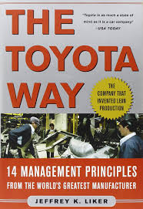
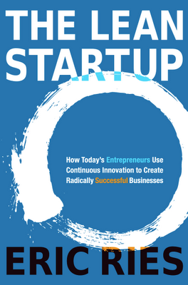
This Photo by Unknown Author is licensed under CC BY-SA

